Slide 2
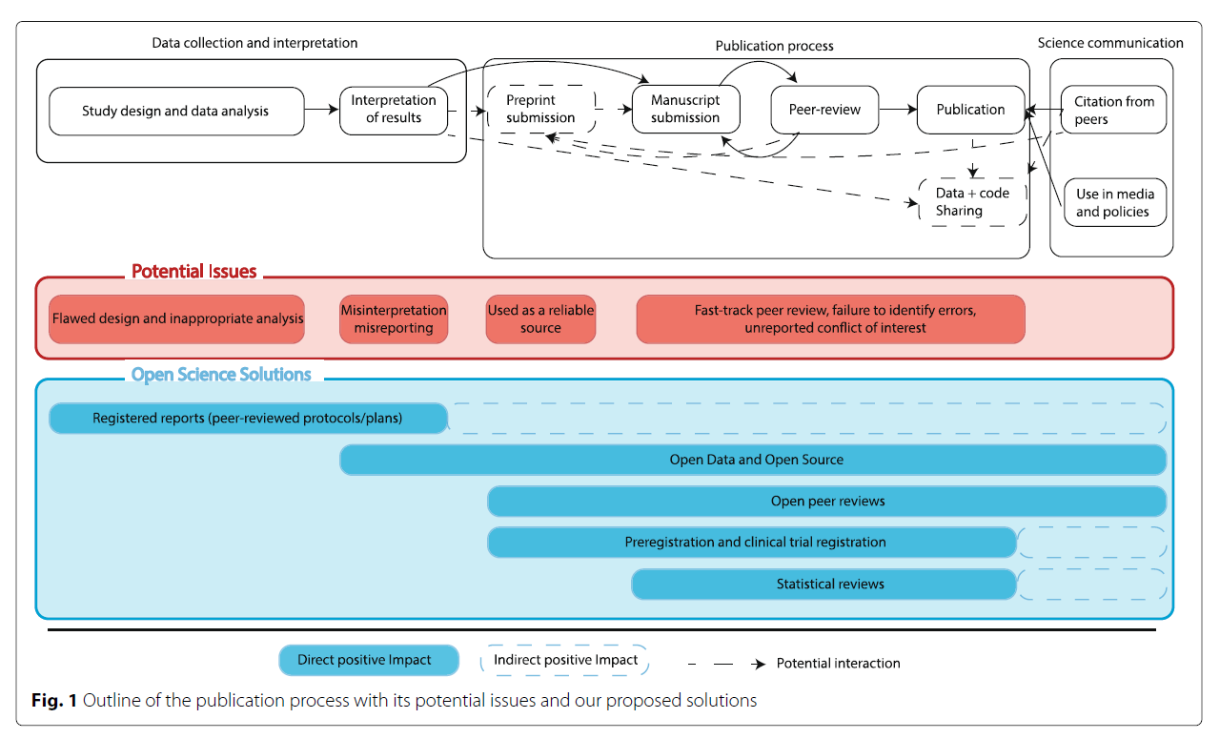
Stage 1 Stage 2 Stage 3

Slide 3
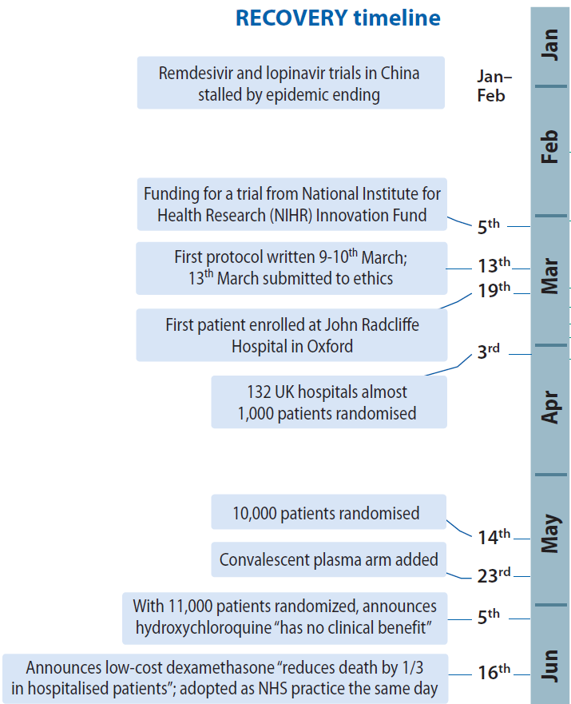
Examples: RECOVERY (good) & Surgisphere (bad)
From funding to 1,000 patients in 1 month
Clear answers for 4 drugs by 4 months
Tikkinen…Glasziou. Nature Medicine, 2020. www.nature.com/articles/s41591-020-1077-z

Slide 4
Stage 1: data collection and interpretation
Identified flaws:
Methodological and statistical issues
RetractionWatch: identified 29 publications (now 216 retractions!)
(rate of .03%, lower than the .04% rate across the literature.)
8/29 were retracted (or had an expression of concern from the editorial board) based on their data analysis or study design.
2 papers retracted, at the authors’ request, to conduct further data analyses
Duplication of research
hydroxychloroquine were conducted in parallel: 218 registered trials were ongoing or already completed as of 26th April 2020
Ethical concerns

Slide 5
Examples: RECOVERY (good) & Surgisphere (bad)
RECOVERY
Randomized
Registered
Public Protocol
Preprint
Lancet/NEJM publications
SURGISPHERE
Observational
Not registered
No protocol
No Preprint
? Lancet publication (Retracted)
From funding to 1,000 patients in 1 month
Clear answers for 4 drugs by 4 months
Tikkinen…Glasziou. Nature Medicine, 2020. www.nature.com/articles/s41591-020-1077-z

Slide 6
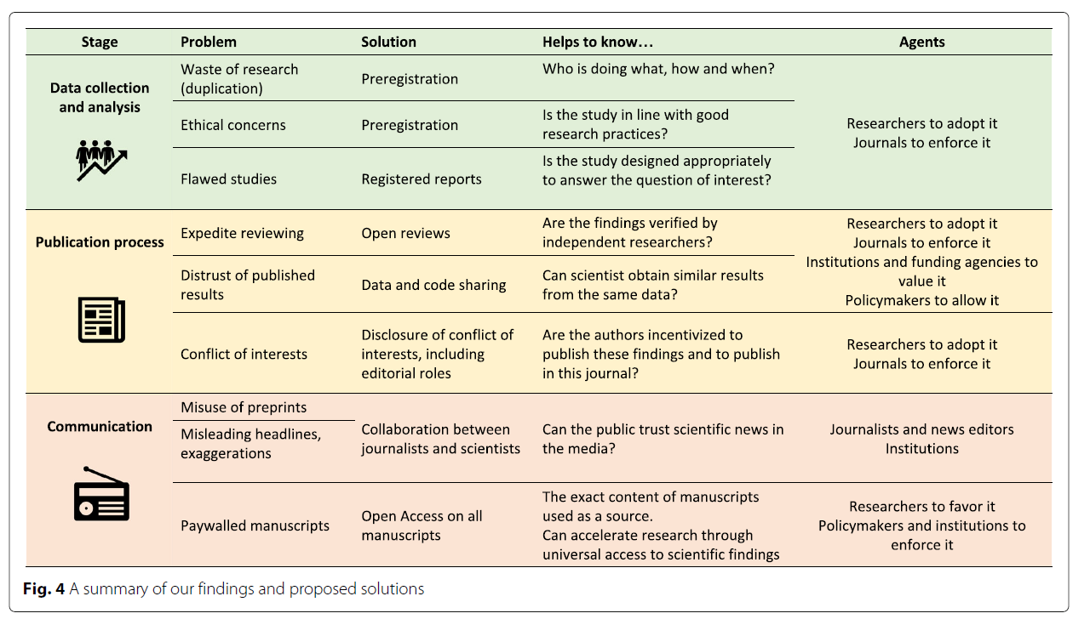
Comments & Other solutions
Are fraudulent studies registered? (PS warn about fake registration)
Could we get automated checking for journals – need linking in Abstracts
Tools for funders to check on duplication
Balance of reproducibility vs waste in duplication – how many is OK?
(Need summary of current data plus likely future)

Slide 7
Stage 3: Communication
“A surge of preprints and their misuse”
MedRxiv
July-Dec 2019 - 807 preprint
Jan-June 2020 - 6,771 preprints!
High mentions in news (3,288 before mid-July) and blogs (313).
Pros
“More timely, avoids duplication, early feedback” (Eg RECOVERY compared to TOGETHER which had 6 month delay of results)
Cons
Misuse, particularly news and general public

Slide 8
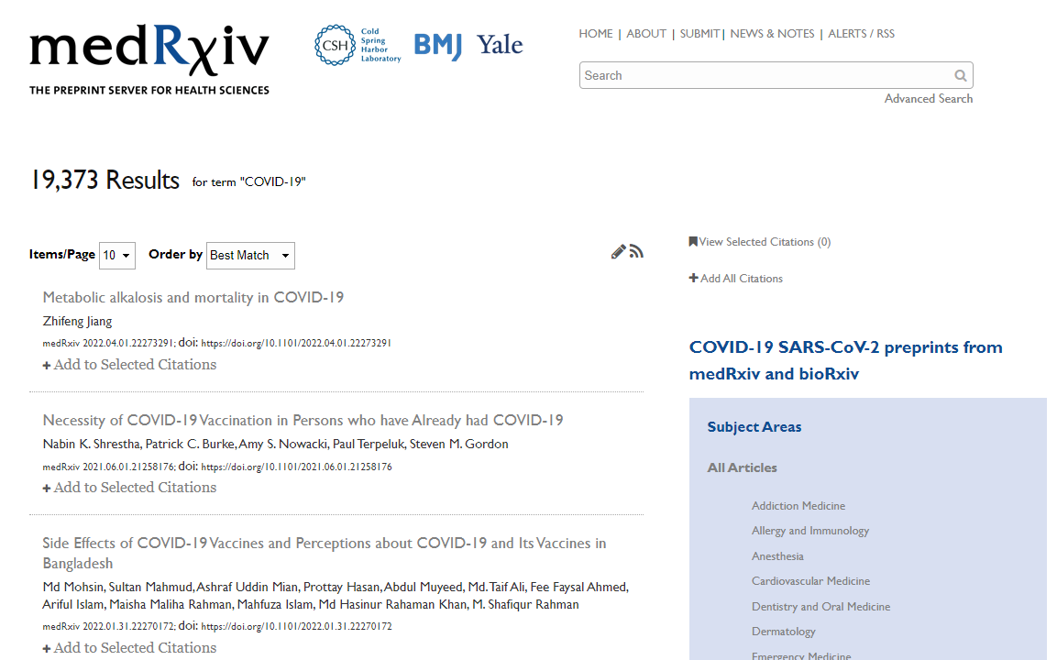
MedRxiv processes

Slide 9
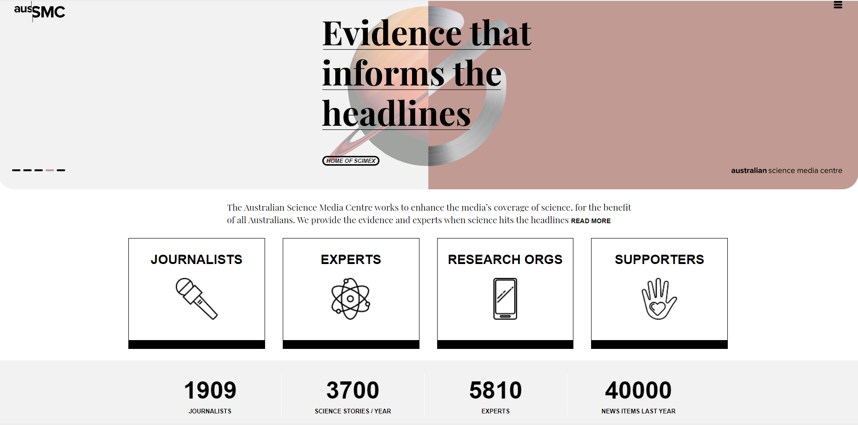

Slide 10
Comments & Other solutions?
Automation to HELP human authors
Need to train/help journalists and public – but problematic because of fragmentation of media
Fast-track pre-prints? Or other specific categories.
Could add comments and revisions of pre-print in submission to journals.
Problem of selection of +ve papers only (or sometimes not really!) by conspiracy sites.

Slide 11
Stage 2: publication process
Identified flaws
Expedited reviewing and conflicts of interest
Time reduced by 10-15 fold (= good if maintains good peer review)
“Of these 8,455 publications, 699 (8.3%) from 341 different peer-reviewed journals were reviewed and accepted for publication either on the day of submission (n = 311) or the day after (n = 388).”
“an editorial conflict of interest was observed in 297 (42.5%) articles.” eg editor or board member
Distrust of published results

